Slide 1
The Last Week
Of Jesus’ Life
The Resurrection (The Ascension)
1 Corinthians 15:1-19
December 21, 2022

Slide 2
The Resurrection,
This was the fundamental message preached to the world. Acts 2, 3, 4, 5; 10:40-41; 13:30-31; 17:3, 30-31; cf. 1 Corinthians 15:1-4, 12-20
Romans 1:1-4, “Paul, a servant of Jesus Christ, called (to be) an apostle, separated unto the gospel of God, which he promised afore through his prophets in the holy scriptures, concerning his Son, who was born of the seed of David according to the flesh, who was declared (to be) the Son of God with power, according to the spirit of holiness, by the resurrection from the dead; (even) Jesus Christ our Lord”

Slide 3
Evidence – Appearances
The tomb was found empty. Luke 24:1-8, “Why seek ye the living among the dead? He is not here, but is risen.”
Mary Magdalene. Mark 16:9-11; John 20:11-18
The women. Matthew 28:9-10; Luke 24:9-11
Peter. Luke 24:34
The two disciples on their way to Emmaus.
Luke 24:13-15
The eleven (minus one). Luke 24:36-43
To the disciples, including Thomas.
John 20:24-28
The seven disciples at the Sea of Galilee.
John 21:1-14

Slide 4
Jesus’ Eighth Appearance
Matthew 28:16-20; Mark 16:15-16; Luke 24:46-47
The eleven disciples on a mountain in Galilee.
They worshipped Him.
He gave them the “great commission.”
“Then” … Over 500 at once. (1 Corinthians 15:6)
  If the appearance recorded in Matthew 28:7, 10, 16-20 is not the one to which Paul was referring, this resurrection appearance is not mentioned elsewhere in the New Testament.

Slide 5
The Galilean Appearances Foretold
Jesus had told the disciples before His death that after the resurrection He would go into Galilee. Matthew 26:32;
Mark 14:28
The angels at the empty tomb told the women to tell the disciples that Jesus would go to Galilee. Matthew 28:7;
Mark 16:7
Jesus told the women to tell the disciples to go to Galilee and He would see them there. Matthew 28:10
Therefore, sometime after the appearance with the disciples including Thomas, the disciples returned to Galilee.

Slide 6
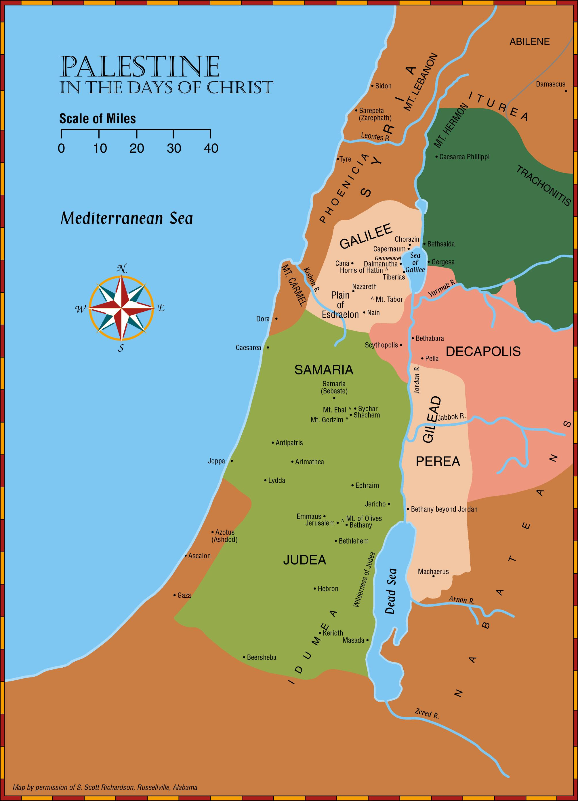
About 80 miles

Slide 7
The Great Commission. “Go Make Disciples” – Matthew 28:19
God calls the lost with gospel teaching. John 6:44-45; Romans 10:8-13, 14-17; 2 Thessalonians 2:14
Disciples made with gospel preaching.
Acts 2:14, 22, 36-38, 40-41
  Word of the gospel. Acts 10:5-6, 22, 33; 11:14; 15:7
  God’s will that the gospel is preached. Acts 16:9-10

